Slide 1
Doppler Radar Measurements
EE492-PROJECT
Ahmet Yasin Bulut - 250206001
Emre Nedim Hepsağ - 250206012
Advisor: Fatih Yaman
Notes:
Hello, we are ahmet and emre.
In this presentation, we will talk about our project which is building a switchable doppler radars to take measurements and compare.

Slide 2
OUTLINE
Introduction
Problem Definition
Proposed Solution
Result and Discussion
Conclusion
Notes:
Today, we will first give introductive information about the area. Then we will mention the problems we consider.
After that we will show our solutions, how these are resulted and the conclusion of the work.

Slide 3
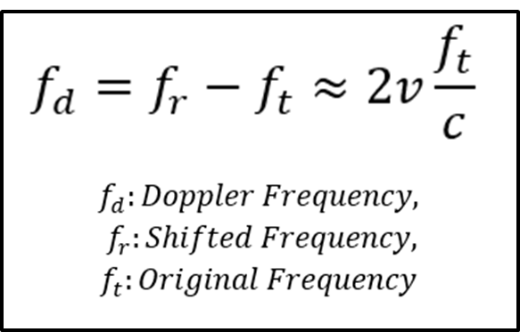
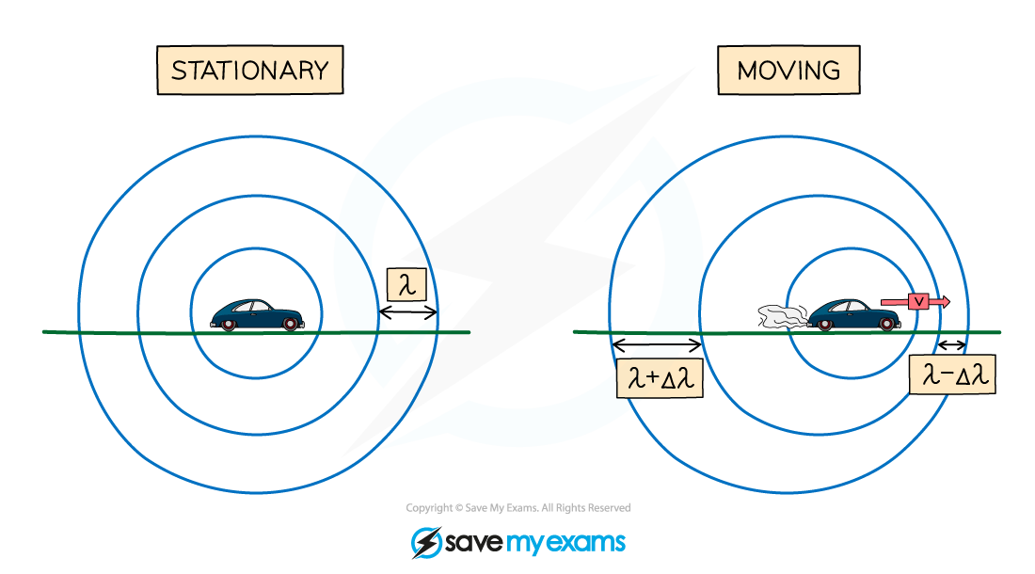
Doppler Radars
Doppler Effect
Radar Bands
CW Radar
Figure 1: Doppler Effect
Notes:
A radar is an electromagnetic sensor to determine the distance, angle or velocity of an object. In this project we concerned with doppler radar. Doppler is an effect which happens when an object has a velocity relation to the wave source or observer. Doppler radar uses this effect to detect the speed of an object.
Doppler radars can be operated in different bands, in this project we built S band and C band radars, which are in 2.45 and 5.8 GHz.
In radar applications, different types of systems can be used for different detections, such as continuous wave, ultrawideband impulse or pulse wave radars.
We will focus on the continous wave radars which are better at doppler shift detection because of continous receiving.

Slide 4
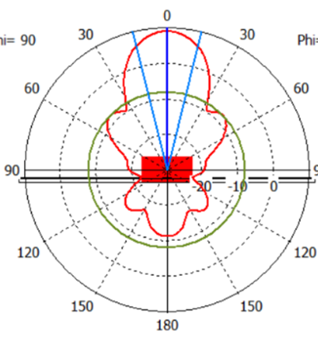
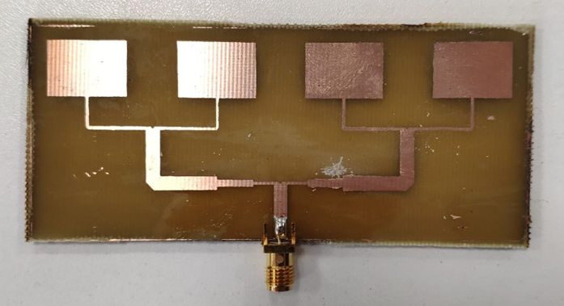
Antennas
Previous Works on Antennas
Antenna Parameters
Figure 3: Antenna Pattern
Figure 2: Realized Antenna
Notes:
In last term, we studied on directional antennas for doppler radars in our project. We realized an array antenna to use in a doppler radar.
In this design, the most important parameters we discuss was return loss, directivity and the gain of it.
Gain of an antenna can be increased by creating more focused and efficent antennas with high directivity and low return loss.
Its important because gain provide us more radar range.

Slide 5
Microwave Components
Passive Components
Splitter/combiner
Attenuators
Antennas
Active Components
Voltage Controlled Oscillator (VCO)
Amplifier
Mixer
Notes:
Also, in building the radar system, we used another components besides our antenna.
Splitter and combiners helps us to divide our incident wave, and attenuators helps us to decrease the power of the incident wave to protect next active component.
Active components are working with additional dc voltage. VCO generates an oscillating wave and amplifier helps us to increase the power of this wave.
Mixer is one of the most important components of heterodyne receiver. It helps us to convert RF signal to IF band and so, in our radar system we can get the output of detection.

Slide 6
PROBLEM DEFINITION
Measurements with a Doppler Radar
Building 5.8GHz Doppler Radar
Designing a Portable System
Designing Additional Components
Manufacturing
Notes:
Now, I will continue with the problems of our project by mentioning them one by one.

Slide 7
Measurements with a Doppler Radar
Rebuilding 2.45GHz doppler radar
Audio amplifier circuit
Calculating expected results
Notes:
We had an 2.4 Ghz doppler radar system which is builded before. So, we first wanted to see if it is operating, fix the problems and see the resulting outputs.
Firstly, we tried to understand the concept of the MIT Cantenna Radar system which is source of inspiration of this system.
For taking the output to the computer we also must rebuild the audio amplifier circuit, and compare velocity calculation with an known velocity.

Slide 8
Building 5.8GHz Doppler Radar
Designing 5.8GHz doppler radar
Checking datasheets and designing the circuit
Checking if the components work
Notes:
Secondly, we wanted to design 5.8 Ghz radar system.
We can use power meter to adjust input and output powers of the system.
Also, we need to build another audio amplifier circuit because we don’t have a second one.

Slide 9
Designing a Portable System
Platform of the System
Compact system
Power Supply Circuit
Easy to switch between radars
Comparable 2.4 & 5.8 GHz systems
Notes:
Moreover, the MIT system is built on a wooden platform and the components are screwed.
We wanted to change that, so our system will be small and portable.
But making it portable create a need for power supply circuit.
Furthermore, for a radar comparison, our radar system should be similar, for this we need to use similar antennas and power levels.
We also wanted to design a switch mechanism between the radars, so a more compact designs will be avaliable and measurements will be easier.

Slide 10
Designing Additional Components
Designing Additional Components
Receiver antenna
Splitter
Manufacturing
Expensive Professional production
Unknown dielectric constant
New manufacturing method
Notes:
For completing the radars, we need additional components, like a similar receiver antenna and a power splitter.
If we wanted to realize them with our own, we wanted to find an inexpensive solution with using the materials we already had.

Slide 11
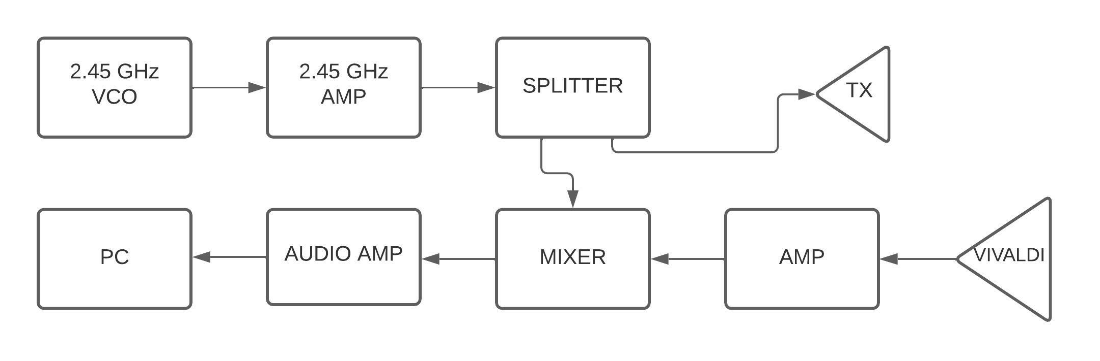
Measurement of a Doppler Radar
Figure 4: Block Diagram of the 2.45 GHz Radar System
Coherent CW Doppler Radar System
Power Measurements of Inputs
Notes:
You can see the first radar system we built. It is a simple continous wave doppler radar.
It uses the coherent radar architecture in the receiver part, and with mixer component, received signal frequency difference is obtained on the input of the audio amplifier.
Before activating the system, we controlled all input signals and compare them with datasheet input power limits. Then we use the tune voltage to generate a 2.45 GHz input signal.

Slide 12
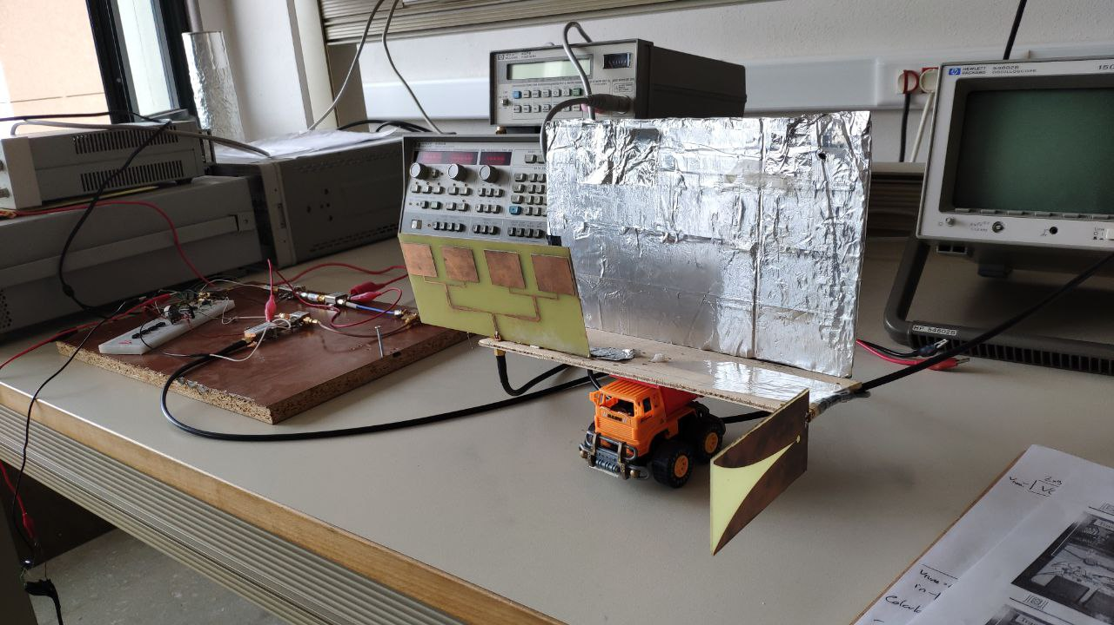
Measurement of a Doppler Radar
Figure 5: First Activated System
Notes:
In this figure the antennas and the platform of the radar can be seen.

Slide 13
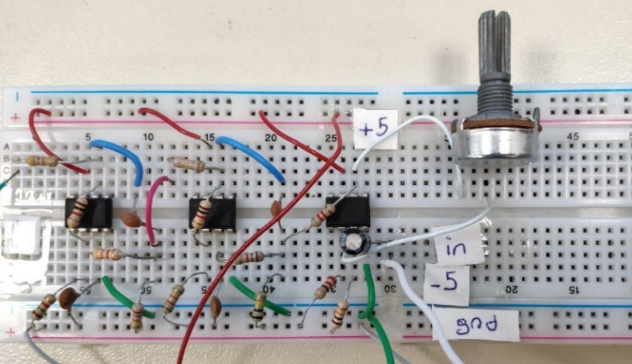
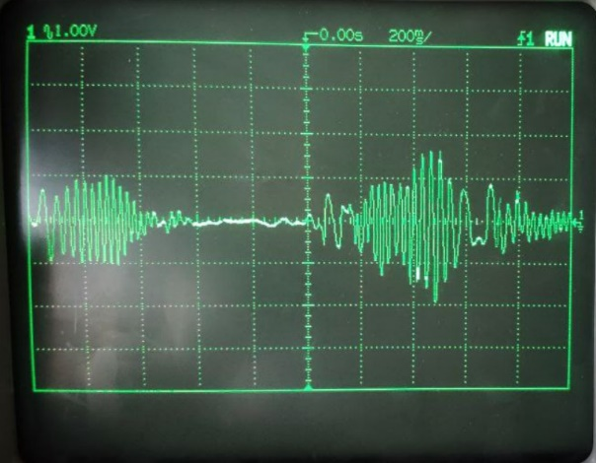
Measurement of a Doppler Radar
Rebuilding Audio Amplifier Circuit
Figure 6: Audio Amplifier
Figure 7: Oscilloscope Result
Notes:
To take output we rebuild the audio amplifier circuit with our lowpass filter and IF amplifier designs.
After a meaningful signal is observed on the oscilloscope, we take the output signal into the computer with and AUX cable, and recorded it on computer with a third party application.

Slide 14
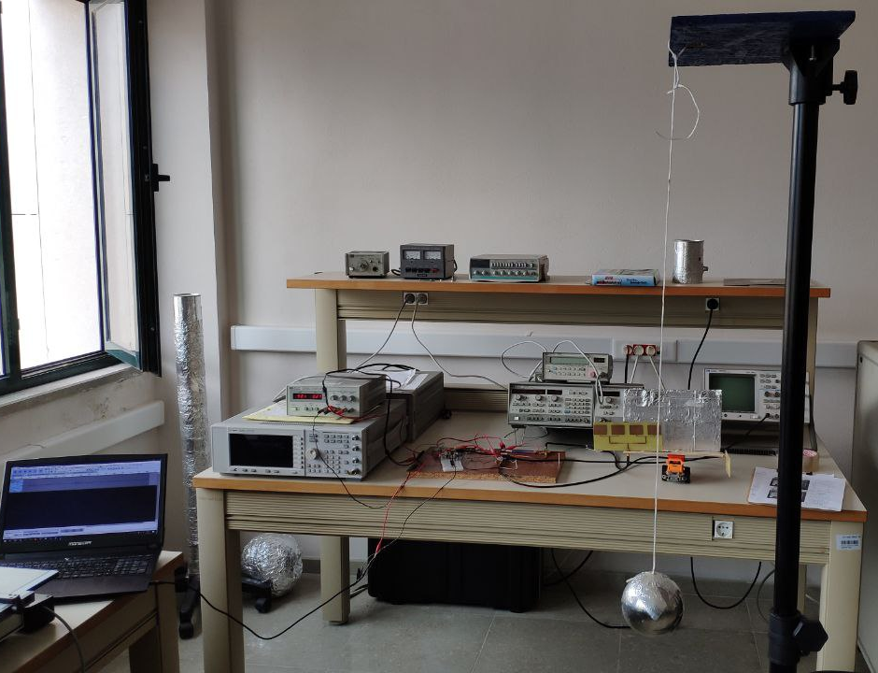
Measurement of a Doppler Radar
Figure 8: Pendulum System
Figure 9: Pendulum Result
Notes:
To obtain a known velocity and compare the accuracy, we used a metal ball with a pendulum system as you can see on the left.
We calculated maximum pendulum velocity and compare the matlab output, it gives a maximum of 3.6 m/sec result and a decreasing velocity plot as we expected.

Slide 15

Building 5.8GHz Doppler Radar
Figure 10: Block Diagram of Second Radar System
Different Active Components
Different Antennas
Notes:
For the second radar implementation, we couldn’t use same active components because of their frequency range.
So we apply the same procedure on the first radar system, and test power input and outputs of our components to combine them.
Also, we used our fabricated antenna and a standart horn antenna to utilize the system.

Slide 16
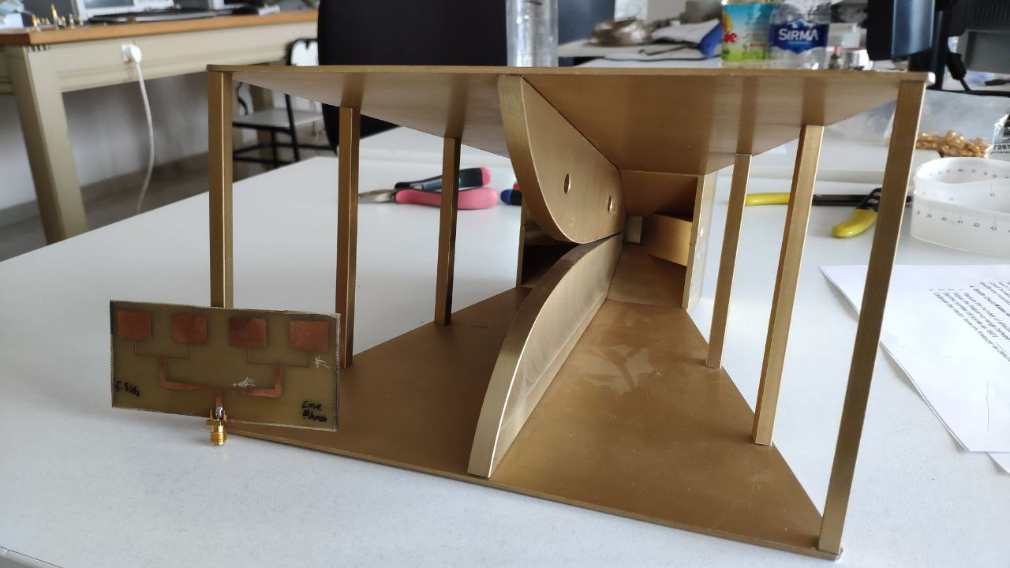
Building 5.8GHz Doppler Radar
Figure 11: Transmitter Microstrip Antenna & Receiver Horn Antenna
Notes:
Actually this horn antenna was very big and heavy for a portable radar, so we decided to fabricate a receiver vivaldi antenna to match the 2.4 GHz radar system.

Slide 17
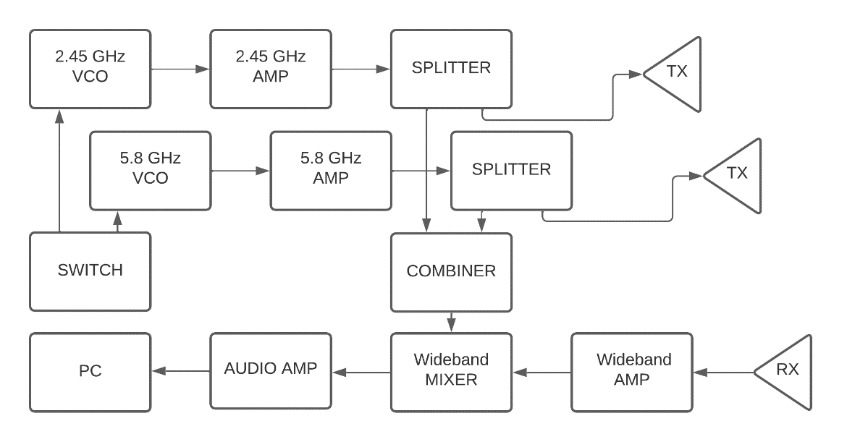
Designing a Portable System
Figure 12: Block Diagram of Combined System
Notes:
For a portable system, we wanted to design a combined radar system which helps us to minimize the overall system and reduce the cost of other components.
Also this configuration make easier to take measurements between two radar frequencies.
Because of these, we decided to use switch on the IF part of the system, so that the switch can change VCO feed and tune voltages.
This system decreases our total power by 3dB ideally because we must use combiner to transmit signal to the receiver part.
On the receiver part we need a wideband mixer and wideband amplifier and a dual band receiver antenna to realize this system.

Slide 18
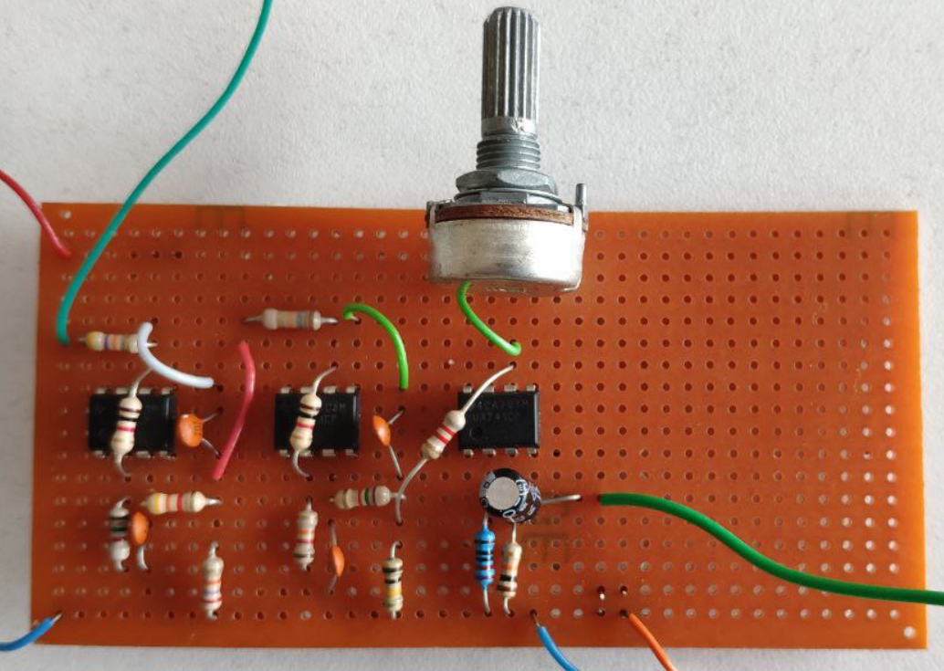
Designing a Portable System
Audio amplifier circuit
Figure 13: Audio Amplifier Circuit
Notes:
Then we minimize the audio amplifier circuit in perforated plate.

Slide 19
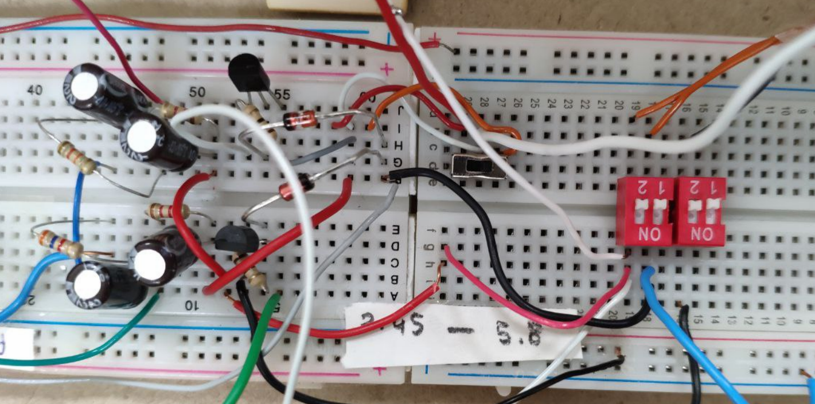
Designing a Portable System
Voltage regulating
Voltage division
And switch circuit
Figure 14: Voltage Adjustment Circuit
Notes:
For constant 5 volt and -5 volt power supply, we used two zener diodes and transistors.
Then we design a voltage division circuit for tune voltages at VCO’s.
After that, we added batteries and switches to disconnect it from power supply.

Slide 20
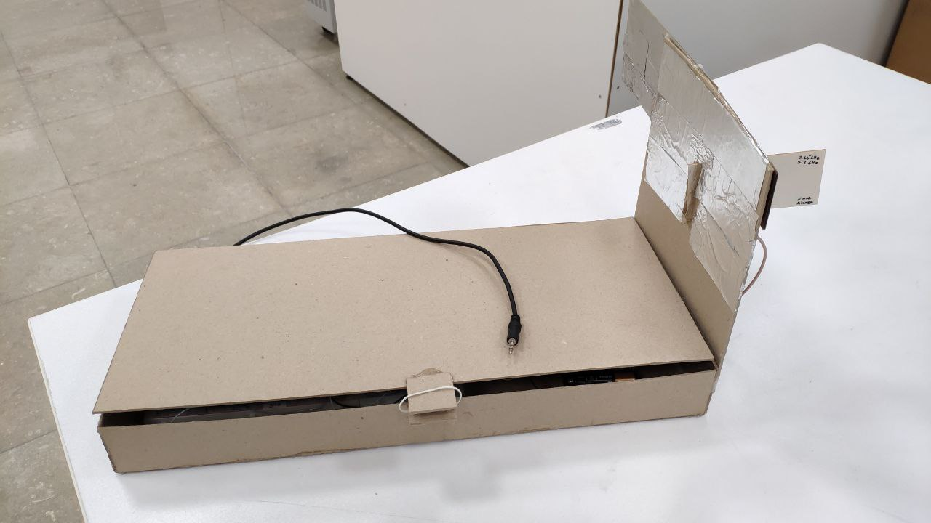
Designing a Portable System
Casing
Figure 15: Completed Case
Notes:
To mount the components and cables, and make it easier to move, we designed a case for the final system.

Slide 21
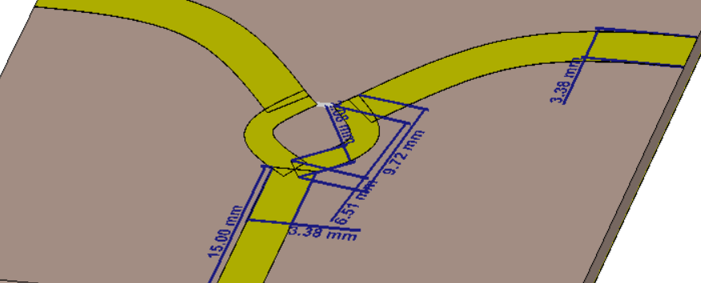
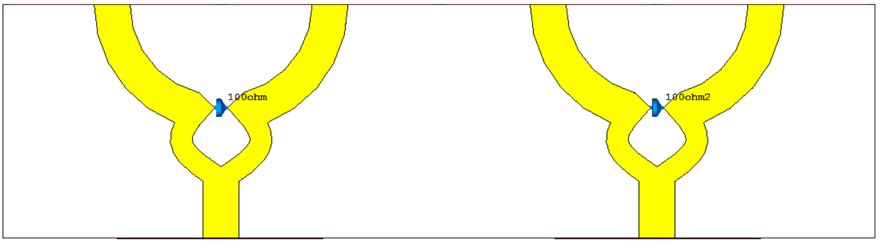
Designing Additional Components
Wilkinson Power Divider
Double Wilkinson Power Divider
Figure 16: Power Divide Designs
Notes:
After deciding the portable system requirements, we designed two wilkinson power dividers in CST.
These splitters provide good isolation, so we can protect the unused active components when one radar system is operating.
We put them in one board according to our other components, so that the system remains compact.

Slide 22
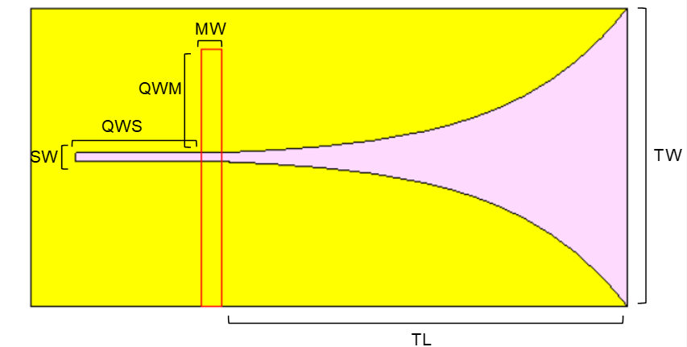
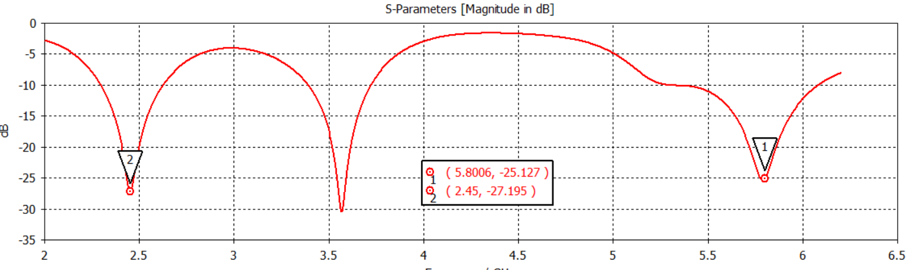
Designing Additional Components
Vivaldi antenna
At 2.4 GHz
6.5 dBi Gain
-27dB Return Loss
At 2.4 GHz
7.5 dBi Gain
-25dB Return Loss
Figure 17: Geometry & S11 Parameter of Proposed VivaldiC
Notes:
Secondly, we designed a dual band vivaldi antenna. This antenna can replace horn antenna for our application, so we can make our system mobile with small antennas.
From the literature, we choose a simple design with slot line stub and microstrip feed as you can see. We decided taper width and length to obtain 5.8 Ghz.
And tune the stub width and length to obtain 2.4 GHz. The red part on the figure is actually the back side of the antenna.
In the fabricated form, we used an aluminium tape strip to reallize microstrip on the backside.
Our S parameter resulted better than 20 db return loss in both bands.
Also, our gain values from the zero degree measurement are 7.5 in 5.8GHz and 6.5 in 2.4 GHz.

Slide 23

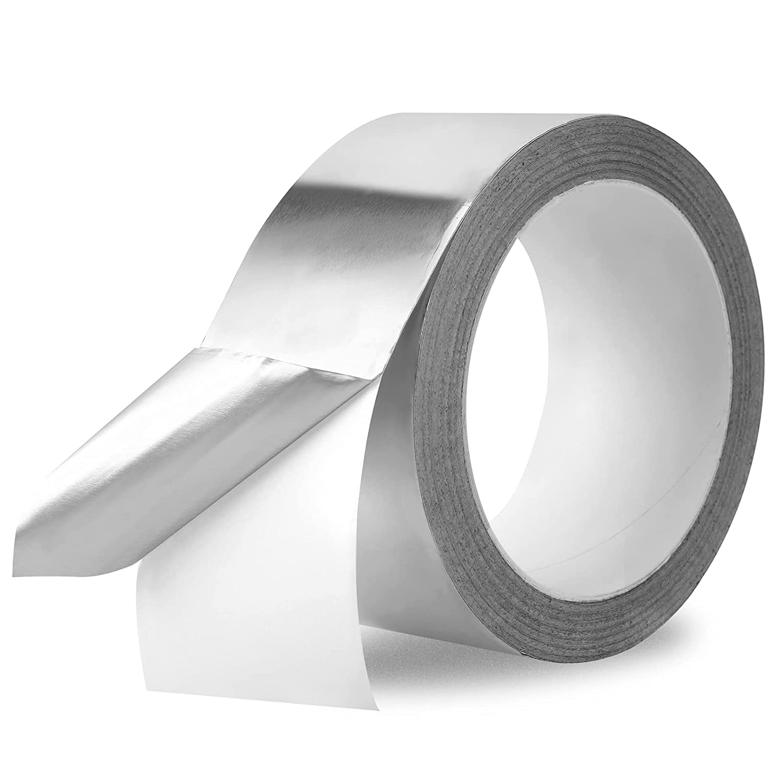
Manufacturing
Photoresist problem
Ground layer
Figure 18: Aluminum Tape & Dry Film
Notes:
Hello, I am Emre. I will go on proposed solution with manufacturing. This term we just had one sided copper clads with no photoresist layer and unknown material. To solve this problem, we came out ideas of adding photoresist layer externally with dry film and ground layer with aluminum tape.

Slide 24
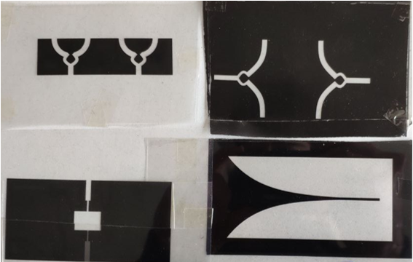
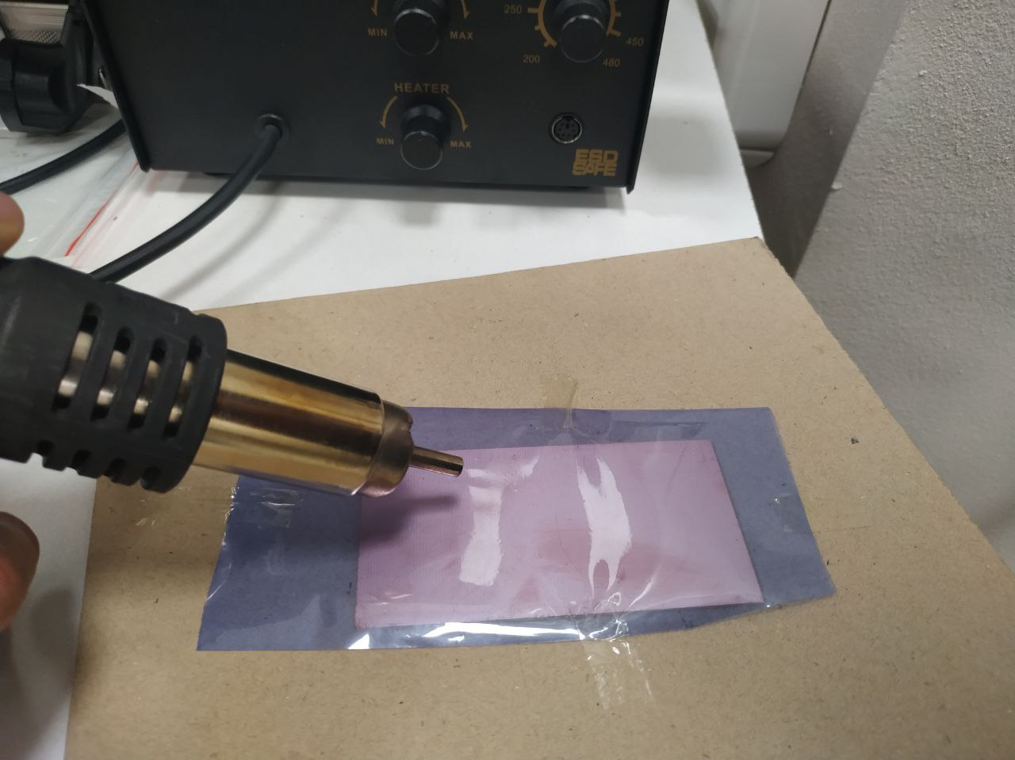
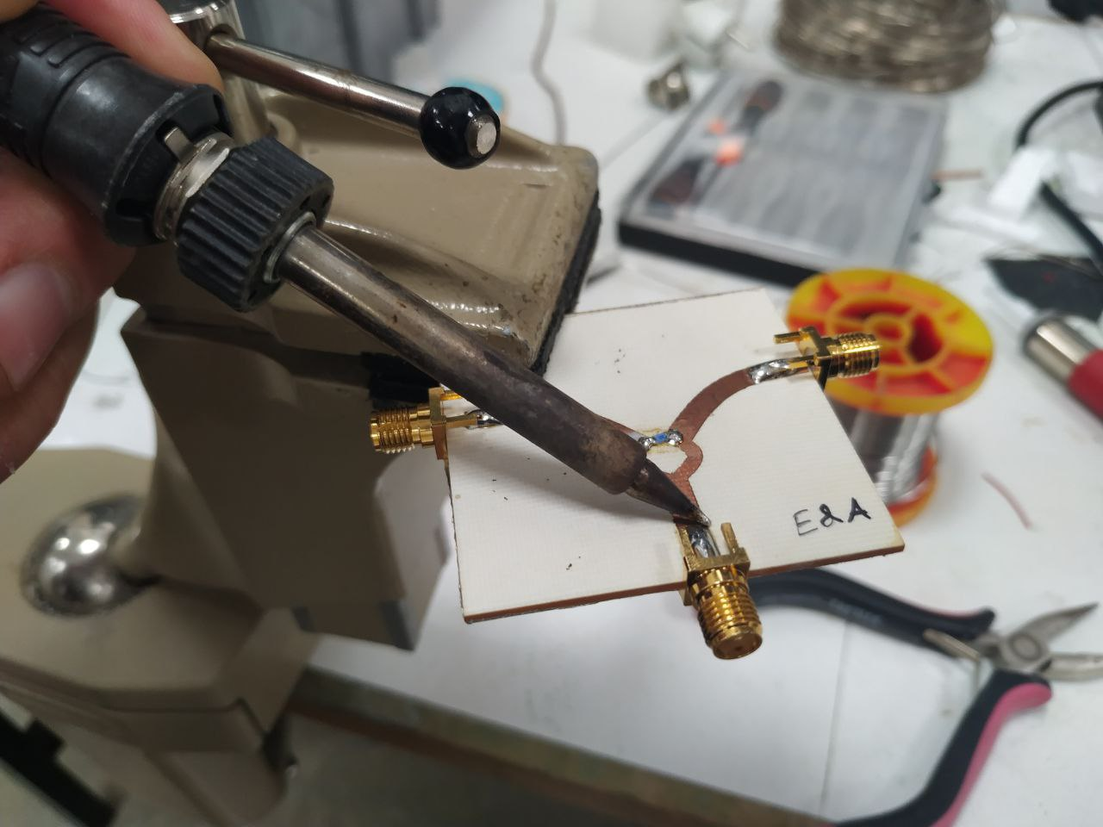
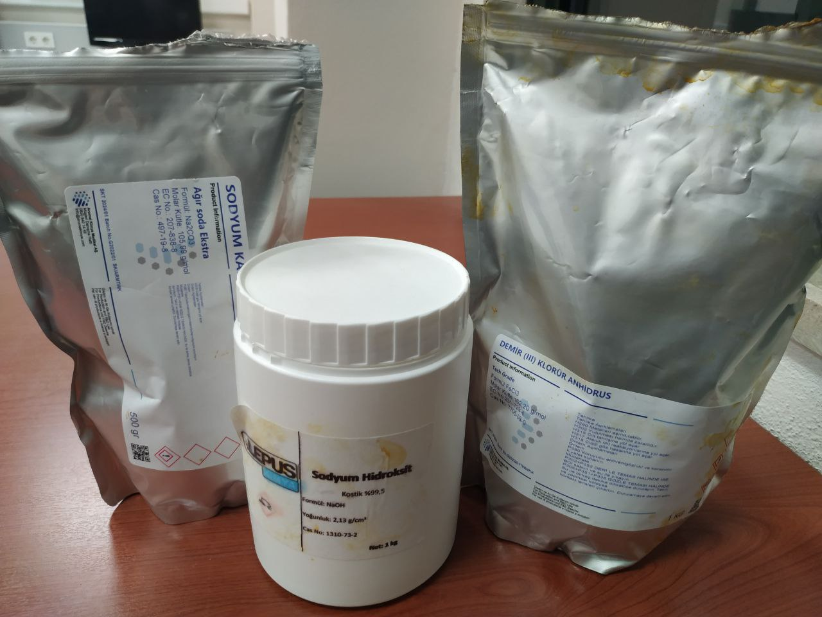
Manufacturing
The Process
Figure 19: Manufacturing Steps
Notes:
Now, let me explain the manufacturing process briefly. At first step surely we design and simulate our component on CST microwave.
Then we need to print mask of the components on a transparent paper as seen in the figure.
Since the photoresist layer is missing, we add it by ourselves with hot air gun. Next, we put the board on uv exposure machine.
And lastly, with 3 different chemicals we developed the photoresist, etched the copper and stripped the remaining photoresist.
After we solder the SMA connecter, the manufacturing process is being done.

Slide 25
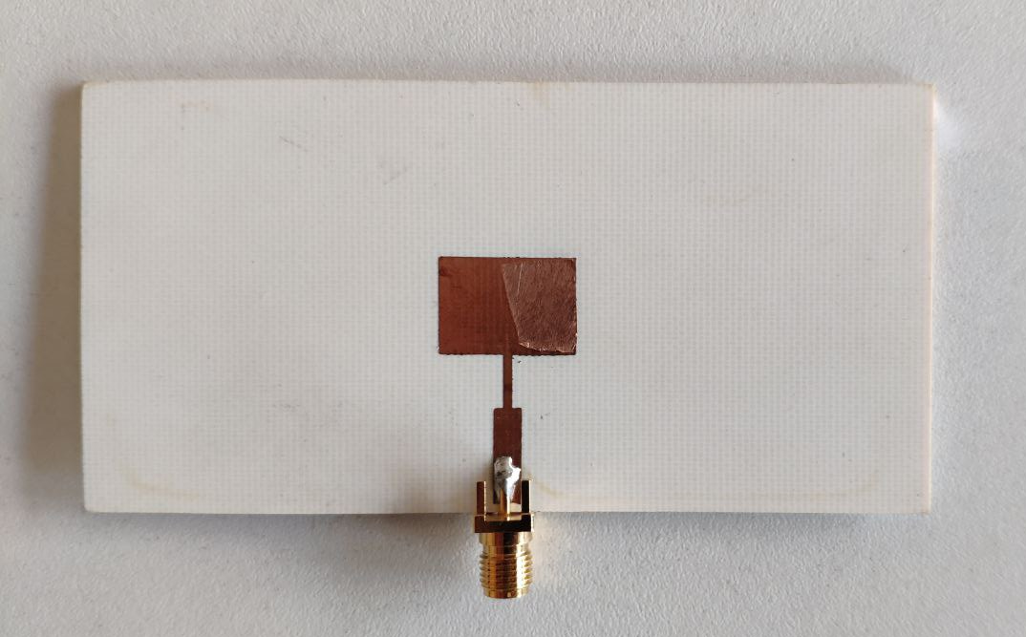
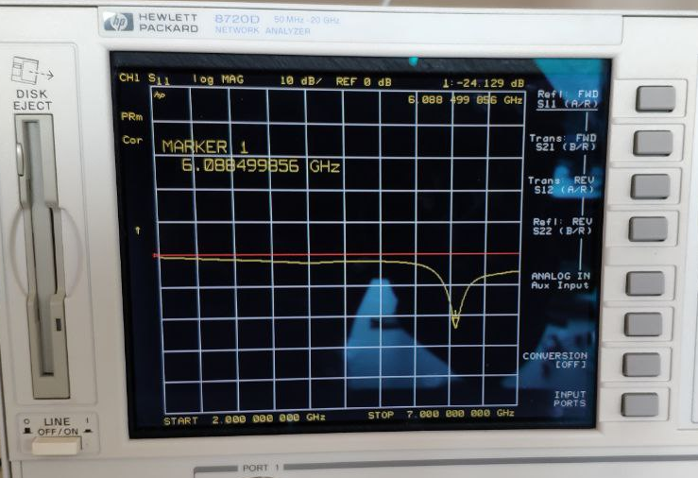
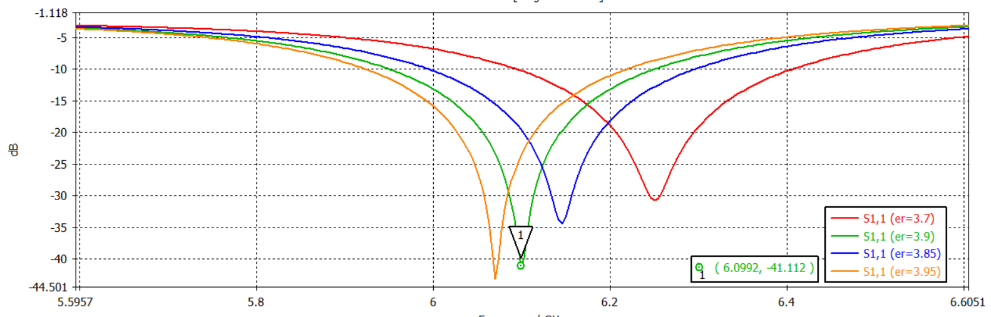
Manufacturing
Dielectric constant measurement
Figure 20: Geometry, Result & S11 of Parameter Sweep
Notes:
Second problem was unknown dielectric. We had several boards with no description on it.
Therefore, to find the dielectic of them, we designed a simple 5.8GHz patch antenna and measured the S11.
As seen in figure up right, operating frequency is approximatelly 6.1 GHz. Therefore, by doing parametric sweep on simulation, we conculued that the dielectic constant of the board is 3.9.

Slide 26
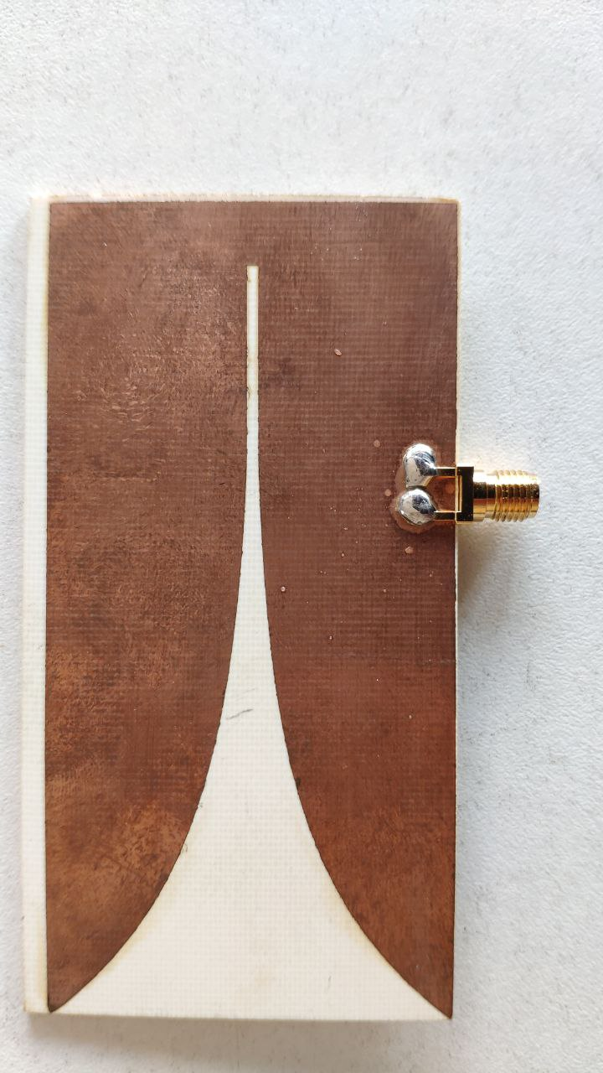
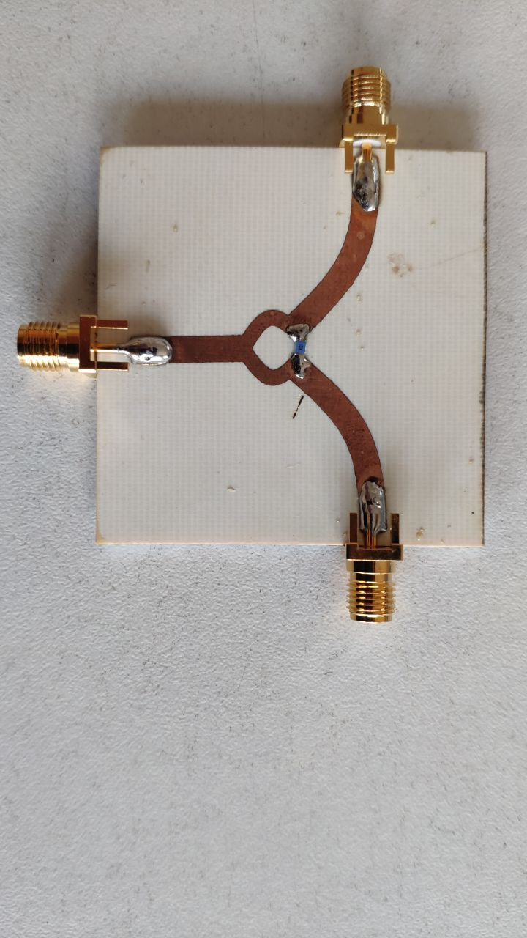
Manufacturing
First splitter and vivaldi antenna attempt failed
Figure 21: Vivaldi antenna (left), wilkinson power divider (right)
Notes:
We did a lot of trial and error for manufacturing. For the antenna the operating frequency was shifted and for the power splitter, the attenuation was higher than expected. Therefore, we reproduced them with different approach.

Slide 27
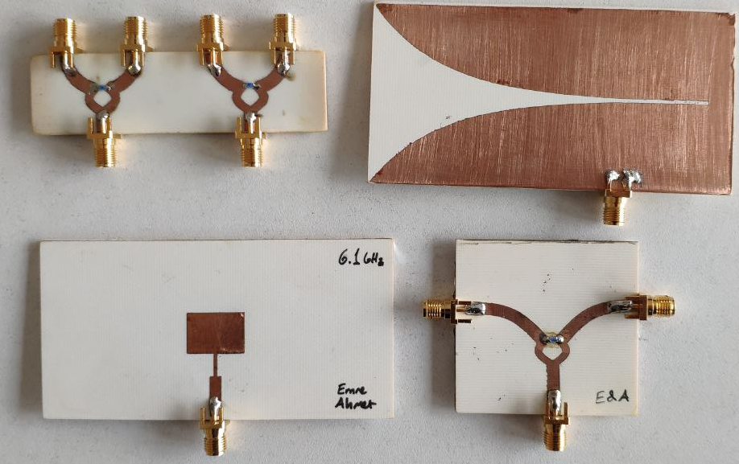
Manufacturing
Figure 22: Manufactured Components
Notes:
These are the most of the components we succesfully manufactured.
There is wilkinson power dividers, a Vivaldi antenna, and a patch antenna.

Slide 28
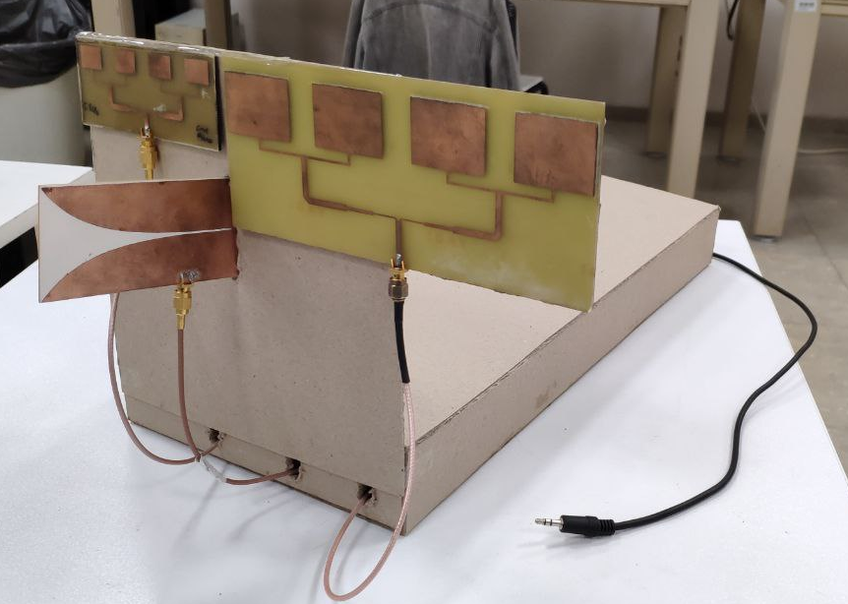
Final Design
Figure 23: Final Design, Antennas & AUX Cable
Notes:
At the final design of the project, our radar was seen like this.
We mounted the antennas in the front of the radar side by side to get same measurements.
And we recorded the measurements with the aux cable as seen in the figure at right.

Slide 29
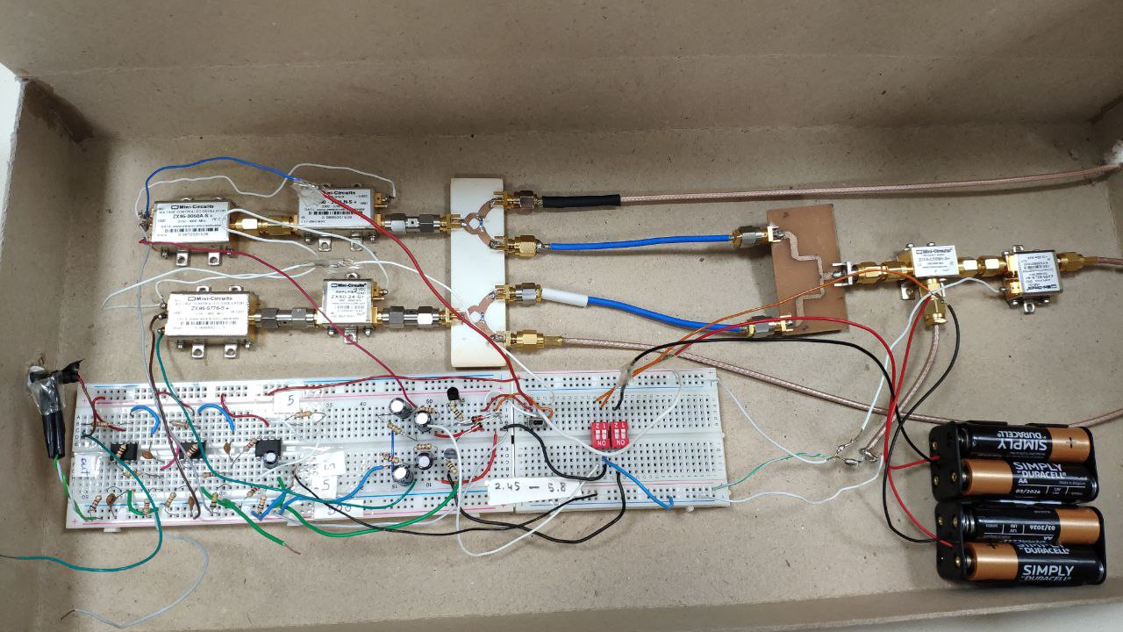
Final Design
Figure 24: Inside of Final Design
Notes:
Lets look inside of it.
On the breadboad, from left to right, there are audio amplifier, voltage divider, voltage ragulator and switching system.
On the top there are voltage controlled oscillators, amplifiers, power divider/combiners and a mixer.

Slide 30
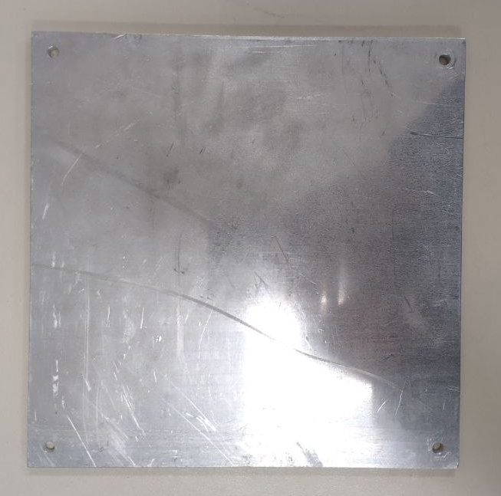
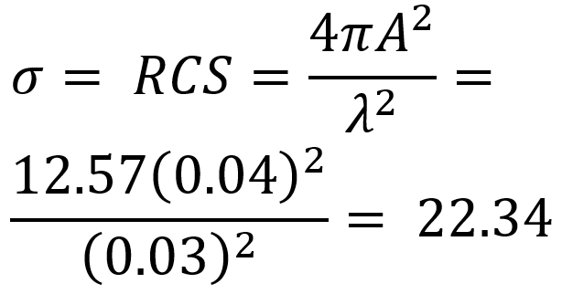
Results
Measurements
Comparisons
Radar Cross Section
Figure 25: Reflective Plate
Notes:
In ressults, After we finalize our desing, we started to measure different situations with 2 radars and compared them.
By doing measurents, we generally used this reflective metal plate becuse it has sufficient radar cross section for our purpose.

Slide 31
System Power Outputs
5.8Ghz
Array Antenna Gain: 8.5dBi
Power: Expected: 23dBm Real: 12dBm
Vivaldi Gain: 7.5dBi
2.45GHz
Array Antenna Gain: 7.5dBi
Power: Expected: 18dBm Real: 13dBm
Vivaldi Gain: 6.5dBi
Notes:
For the system power outputs, we found the gain of the antennas as seen in the slide.
We were expecting power outputs as higher but we measured lower power for both of them.

Slide 32
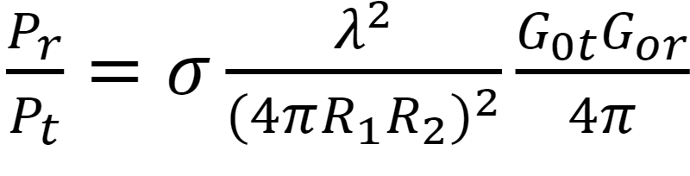
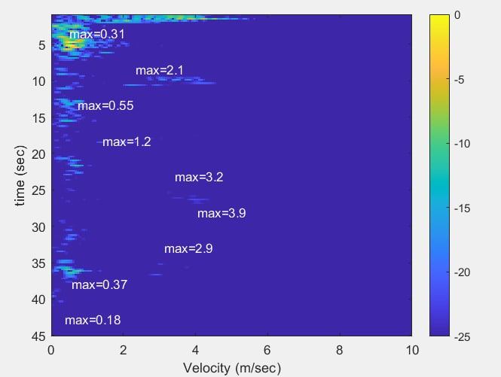
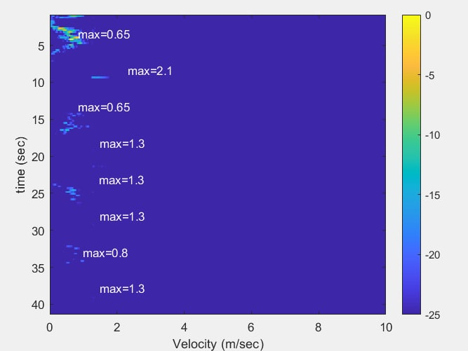
Radar Range
Radar Range Equation
Figure 26: Using Reflective Plate at Different Distances
Max Radar Range for -60dBm:
2.45GHz: 21.49m
5.8GHz: 13.24m
Notes:
For testing the radar range, we first theoritically calculated it with radar range equation by assuming the nosise level as -60dBm.
For 2.45GHz radar, our range is greater than 5.8GHz. To test this we did an experiment by swinging the reflective plate in different range from 1 meter to 12meter.
The graph is simple time and velocity graph. Time is vertical and velocity is in horizontal axis. As seen in the figure, 2.45GHz doppler radar gives better results at further and 5.8GHz loses its power at the end of the measurement which is 12meter.

Slide 33
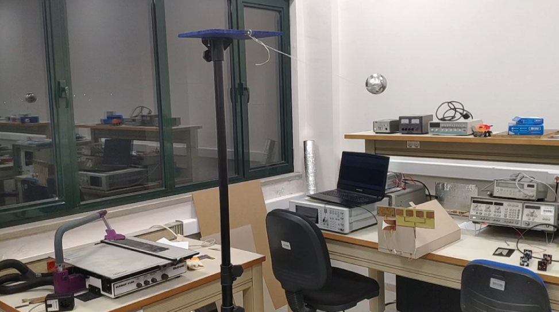
Pendulum
Figure 27: Pendulum Test Configuration
Notes:
To see the accuracy of the radar, we did an pendulum experiment. This is because, we can precisely calculate the speed of the pendulum by energy conservation principle. We found it as 3.9m/s at maximum velocity.

Slide 34
Pendulum
2.45 5.8
Figure 28: Pendulum Test Results
Notes:
When we compare the result, they both clarly see the pendulum swings. We droped the ball at highest point and let it swing. So, exponantial decreament was expected. For accuracy, they both close the 3.9m/s. There is 10% error for 2.45 and 5% for 5.8GHz.

Slide 35
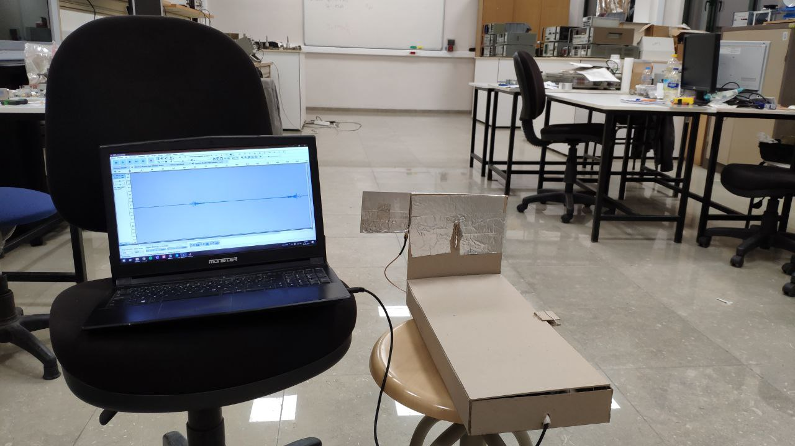
Running
Figure 29: Running Test Configuration
Notes:
To observe what radars detect when we run forward and backward, we did running experiment.
Since, we are in the range of both radars and the software take its reference according to maximum power, we expected to see similar figures.

Slide 36
Running
2.45 5.8
Figure 30: Running Test Results
Notes:
As seen in the figures, at the first target goes forward at the speed of 2.3 m/s and stops for seconds then comes back at the same speed. Both radar measurements are same as expected.
Normally, radars also see the target in the middle of the time but when we adjust the software to eliminate the noise, we also loose those signal too.
This is a tradeoff for doppler radar. In other words, if we want to see further we lose accuracy.

Slide 37
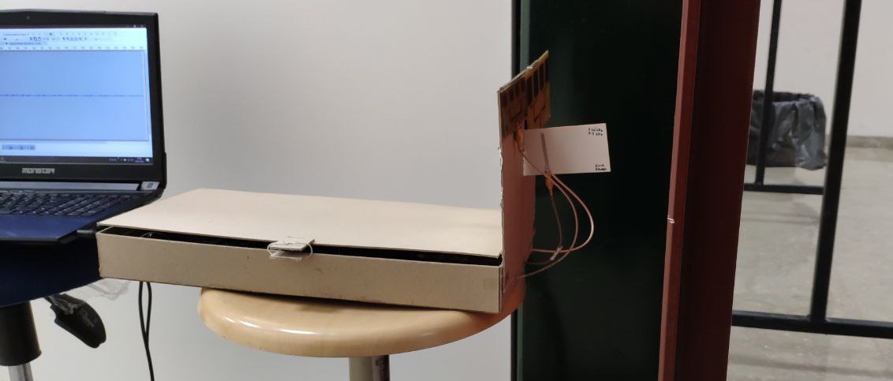
Behind the Door (5cm)
Figure 31: Behind the Door Test Configuration
Notes:
For the next experiments, we measured how the radar differs when there is an obstacle in front of it. We started it with a 5cm wooden door. Similar to radar range test, we swinged the reflective plate at definite positons to see if we get a signal back.
For your information, for these experiments to see any distinct power is more important than its accuracy. Also, the velocity of the target is unknown. Therefore we didn’t add velocity of them in the results.

Slide 38
Behind the Door - 2.45
1m
2m
3m
4m
5m
Figure 32: Handrail Test Result, -35db Threshold (left), -45dB Threshold (right)
Notes:
When there is an obstacle, received power decreases and noise starts to dominate.
Therefore, to see the detection more clearly, we applied different tresholds to both of them which shows that there is a trade off between high power velocity accuracy and low power detection.
As we see in the figure, 2.45GHz doppler radar can detect the target 5m away behind a door.

Slide 39
Behind the Door - 5.8
1m
2m
3m
4m
5m
Figure 33: Handrail Test Result, -35db Threshold (left), -45dB Threshold (right)
Notes:
As we see in the figure, 5.8GHz doppler radar can not detect the target after 3meter.
Even though we see little signals at lesser treshold, it is not significant.

Slide 40
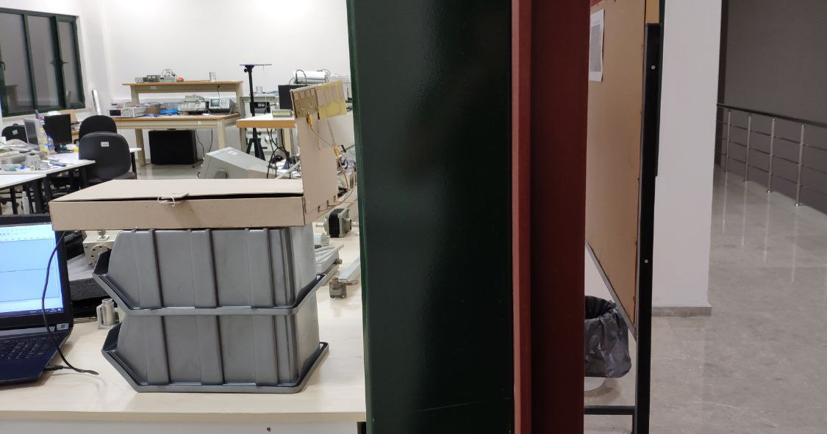
Behind the Wall (22cm)
Figure 34: Behind the Wall Test Configuration
Notes:
To extend the experiment we followed it up with a 22cm concrete Wall experiment with similar procedure but we expect weaker signals this time.

Slide 41
Behind the Wall
2.45 5.8
1m
2m
3m
Figure 35: Behind the Wall Test Result , -30db Threshold
Notes:
Just like door experiment, power decreases when the target gets further and 2.45GHz gives better result. Since, 5.8GHz has weaker signals, it has more noise.

Slide 42
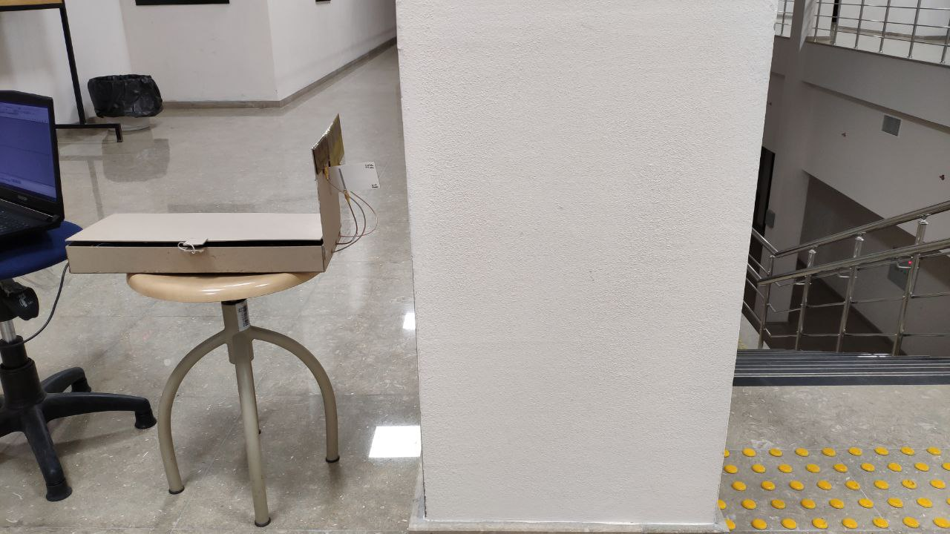
Behind the Pillar
Figure 36: Behind the Pillar Test Configuration
Notes:
To finalize the obstacle experiment, we did measurement behind a pillar.
We expect to see very little power because the pillar has a lot of metal rod which reflect the signals back.

Slide 43
Behind the Pillar
2.45 5.8
Figure 37: Behind the Pillar Test Result – -30db Threshold
Notes:
As seen in the figures, the target movement is lost. Even if we get some signal, noise clearly dominates it.
So, we can say that both of them can not detect anything behind the pillar.

Slide 44
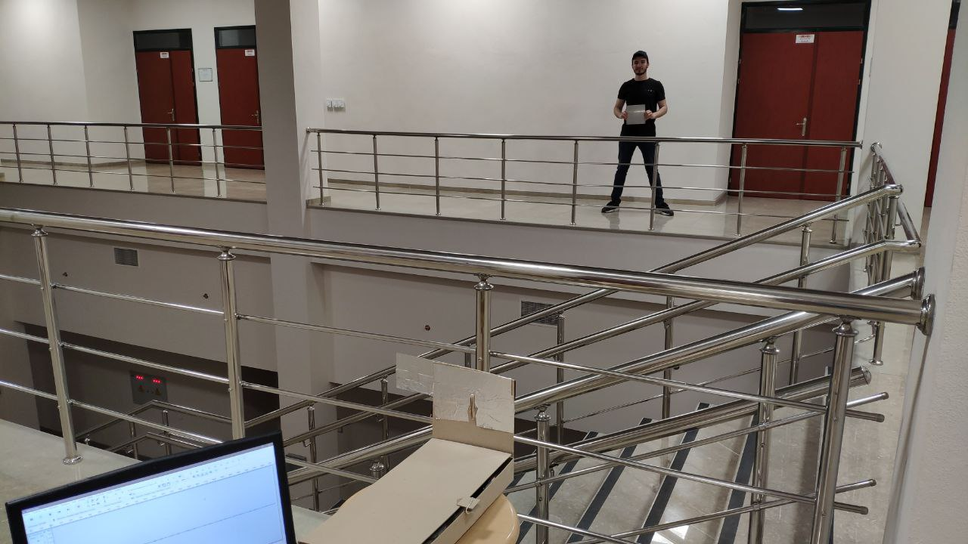
Handrail
Figure 38: Handrail Test Configuration
Notes:
For the next experiment, we wanted to compare the radars when there is scattering particles in front of them. To mimick this situation, we put the device behind handrail and started to record.

Slide 45
Handrail
2.45 5.8
Figure 39: Handrail Test Result – 30db Threshold
Notes:
As seen in the figures, there is slightly difference between the measurement but we can not say that if any of them better than other one. And They did not struggle at all.

Slide 46
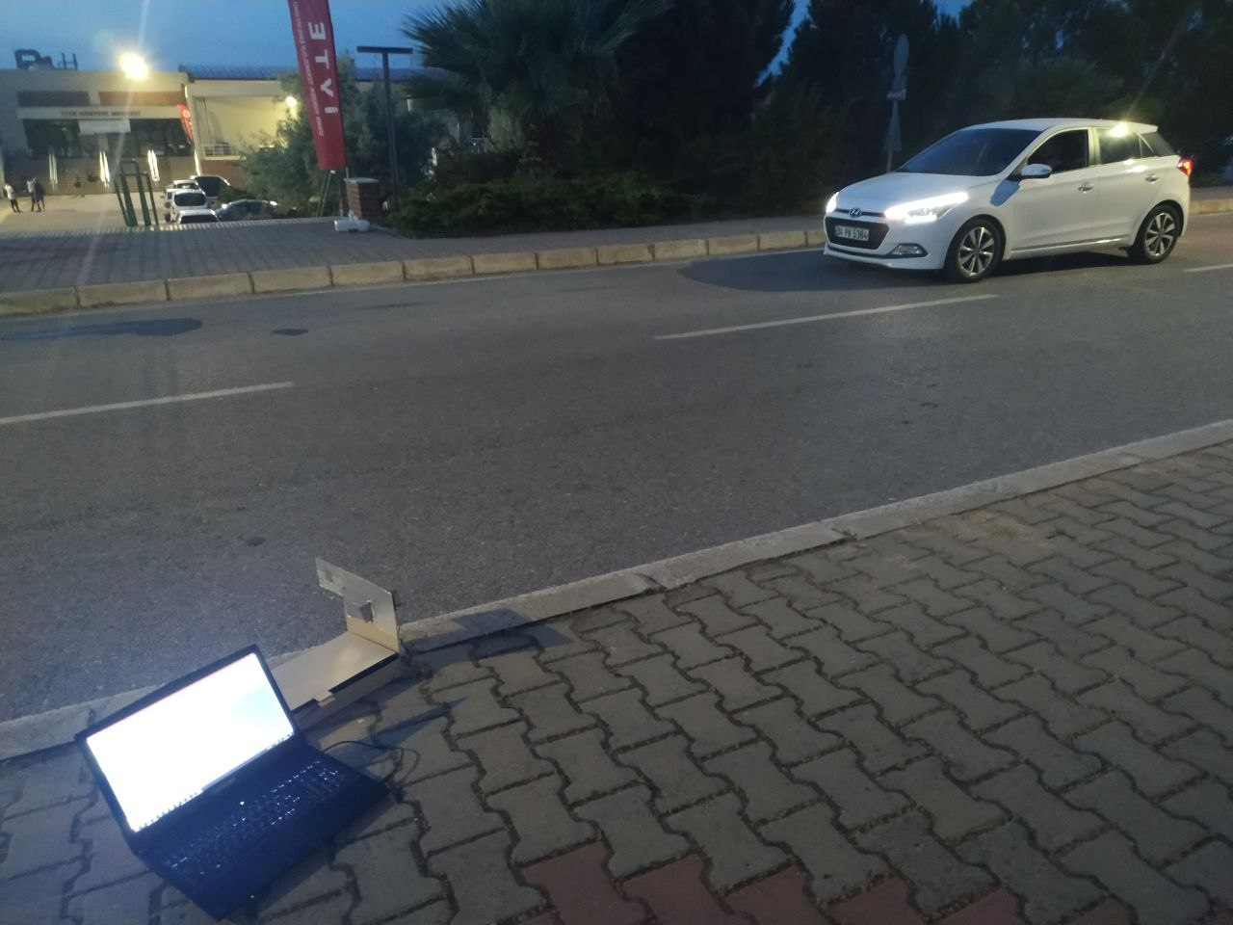
Car Passing Through
Figure 40: Car Test Configuration
Notes:
For the last experiment, we wanted to test if the radar can capture relatively high speed target.
Since car is a metal and big target, it has high RCS approximately 100, which causes the radars to detect it more easily.
For the experiment, we locate the radar as seen in the figure and the car passed with speed of 18.6 m/s.

Slide 47
Car Passing Through
2.45
Figure 41: Car Test Result – 20dB Threshold
Notes:
As we see in the figure, 2.45GHz radar captured the the speed clearly and accurately. There is just 3% error which comes from angle of the radar.

Slide 48
Car Passing Through
5.8
Figure 42: Car Test Result – 20 dB Threshold
Notes:
Again for the 5.8GHz radar, we can clearly see the speed of the car which has slightly more error.

Slide 49
Overall
 | 2.45GHz | 5.8GHz
Range | ✔
Through-Wall | ✔
Scattered Particals | - | -
High Speed | - | -
Notes:
Overall, we can say that for range and through Wall experiments, 2.45GHz radar has better performance. On the other hand for our experiments, we can not say that none of them is better for scattered particles and high speed target measurement.

Slide 50
CONCLUSION
We can produce RF commonents in inexpensive way.
In practice voltage stable power circuits can be complex.
There is no dramatic differences between 2.45GHz and 5.8GHz doppler radar for small range.
Can be improved.
Final thoughts.
Notes:
In conclusion:
It is expensive to order PCB from other companies but we clearly see that with some devices and chemicals, we can produce our board precisely.
Secondly, Even though power circuits seems relativaly simple, in practice, it gets complex and neglected parameters adds up to deflect expected results.
Next, Surely there are differences between 2.45 and 5.8GHz doppler radars for small range usage. However, according to application we can prefer one on other. For example, 5.8GHz antenna is much smaller. It can be prefered for size mattered applications. Or for range applications 2.45GHz can be prefered.
Even though, we added a lot on this device. It can be improved with more stable power supply and better power amplifiers.
Lastly, We think this sytem can help to experiment frequency comparison applications and other doppler radar studies.
This is the end of our presentation. Thank you fofr listening to us.

Slide 51
REFERENCES
[1] A. Pandey, Practical Microstrip and printed antenna design. London, Boston: Artech House, 2019
[2] Radar bands. [Online]. Available: https://www.everythingweather.com/weatherradar/bands.shtml. [Accessed: 27-Nov-2021].
[3] “Radar,” Wikipedia, 24-Nov-2021. [Online]. Available:
https://en.wikipedia.org/wiki/Radar. [Accessed: 27-Nov-2021].
[4] “Doppler effect,” Wikipedia, 18-Oct-2021. [Online]. Available:
https://en.wikipedia.org/wiki/Doppler_effect. [Accessed: 27-Nov-2021]
[5] “Talk:velocity-addition formula/archive 1,” Wikipedia, 16-Jul-2016. [Online].
Available: https://en.wikipedia.org/wiki/Talk:Velocity-addition_formula/Archive_1.
[Accessed: 27-Nov-2021].
[6] G. L. Charvat, Small and short-range radar systems. Boca Raton: CRC Press, Taylor &amp; Francis, 2017.
[7] A. Karatay, D. Orcan, C. Özkal, and F. Yaman, “Implementation and experimental verifications of microstrip antennas for angular scanning of a Doppler radar,” AEU-International Journal of Electronics and Communications, vol. 101, pp. 76–84, 2019.
[8]“Wilkinson isolation,” Microwaves101. [Online]. Available: https://www.microwaves101.com/encyclopedias/wilkinson-isolation. [Accessed: 19-Apr-2022].
[9] “What is Return Loss?,” everything RF, 10-Nov-2018. [Online]. Available: https://www.everythingrf.com/community/what-is-return-loss. [Accessed: 13-Jan-2022].
[10] A. Henkel, “What are S-Parameters?,” everything RF, 06-Aug-2019. [Online]. Available: https://www.everythingrf.com/community/what-are-s-parameters. [Accessed: 13-Jan-2022].
[11] “Main characteristics of chip attenuators and Pat Series: Susumu Deutschland GmbH,” SSMSUSUMU. [Online]. Available: https://www.susumu.co.jp/france/tech/highfrequencychip03.php. [Accessed: 13-Jan-2022].
[12] “What is antenna gain,” NetXL Blog, 10-Jul-2019. [Online]. Available: https://www.netxl.com/blog/networking/antenna-gain/. [Accessed: 13-Jan-2022].
[13] H. T. Friis, “A note on a simple transmission formula,” Proceedings of the IRE, vol. 34, no. 5, pp. 254–256, 1946.
[14] “Photosensitive dry film for PCB (12’ X 20’),” leetechbd. [Online]. Available: https://leetechbd.com/product/photosensitive-dry-film-pcb/. [Accessed: 19-Apr-2022].

